Slide 1
FloorplanSBS: Synthesizing Vector Floorplans by Patch-Based Floorplan Segmentation
Wenming Wu Tianlei Sheng Gaofeng Zhang Liping Zheng
Hefei University of Technology
（This video contains voiceover.）

Slide 2

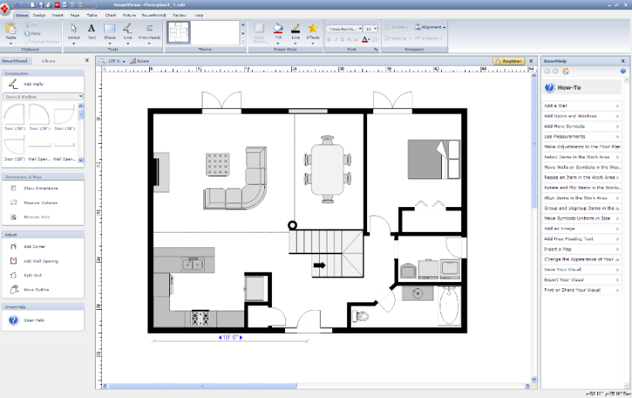
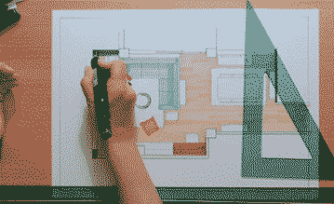
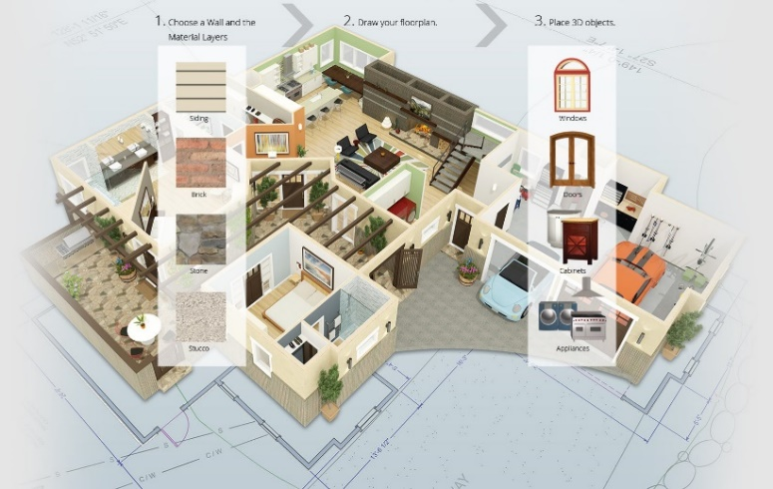
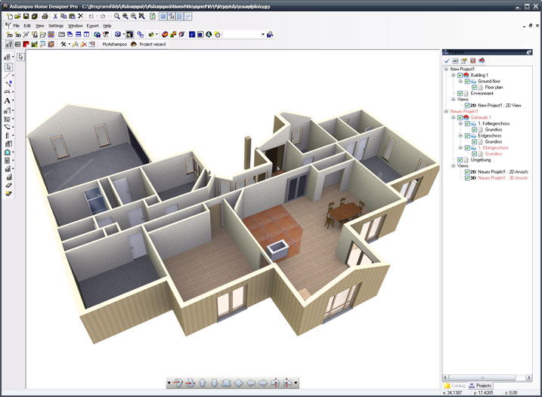
Floorplan generation
Traditional floorplan design relies on manual work, whereas automatic generation can greatly enhance efficiency and the level of intelligence.
Automatic generation
Notes:
Automated vector floorplan generation is valuable for designers to explore potential spatial designs. Traditional floorplan design depends on manual work, which is slow and costly. With architectural intelligence, automatic generation has become a new trend.

Slide 3
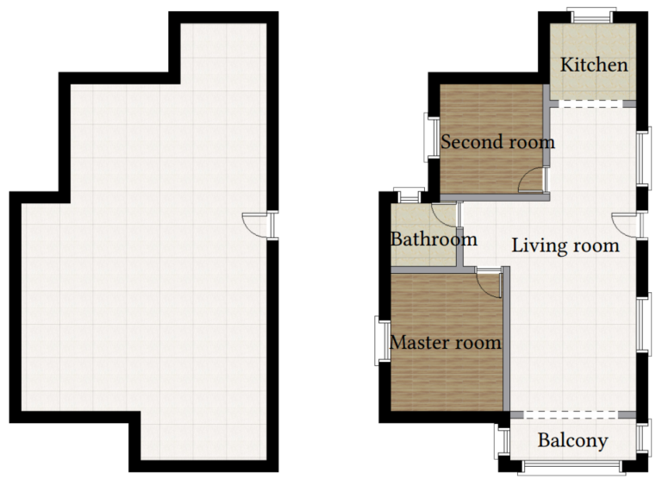
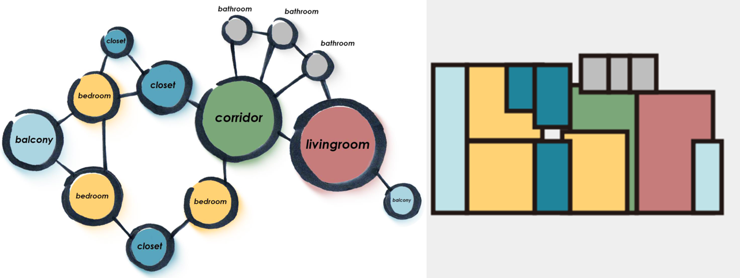
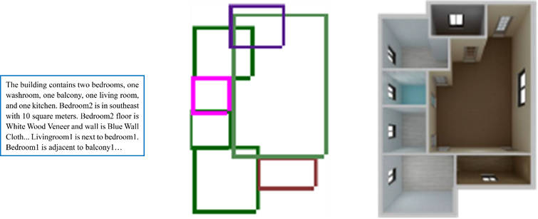
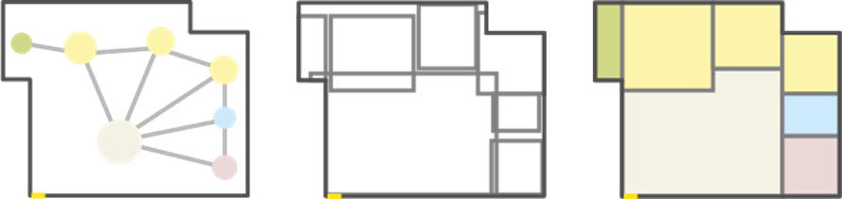
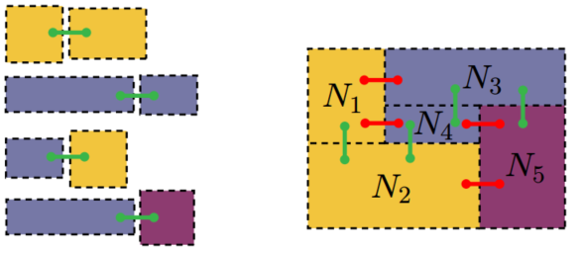
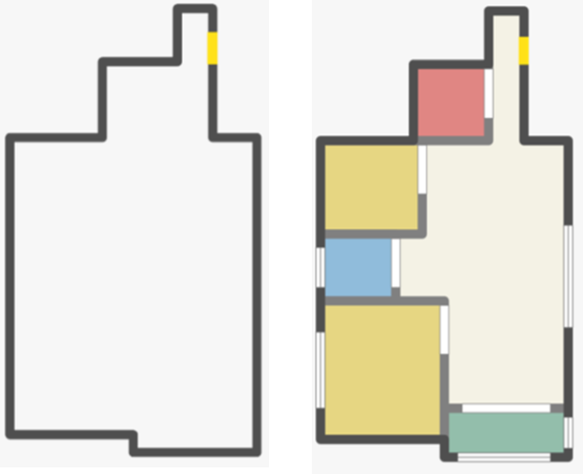
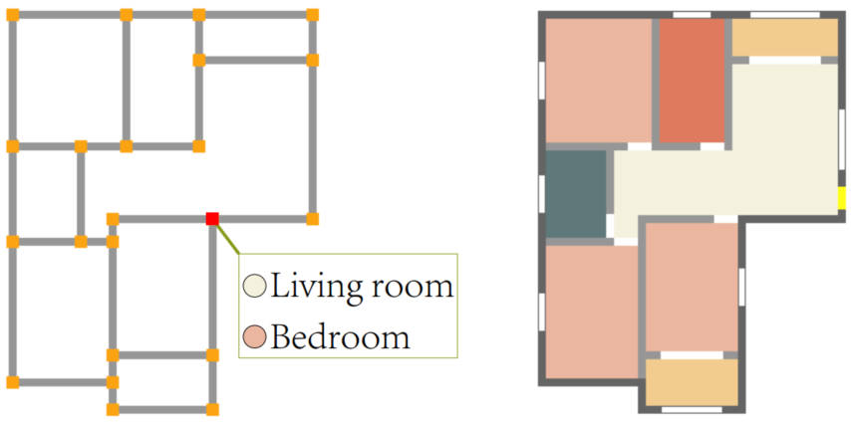
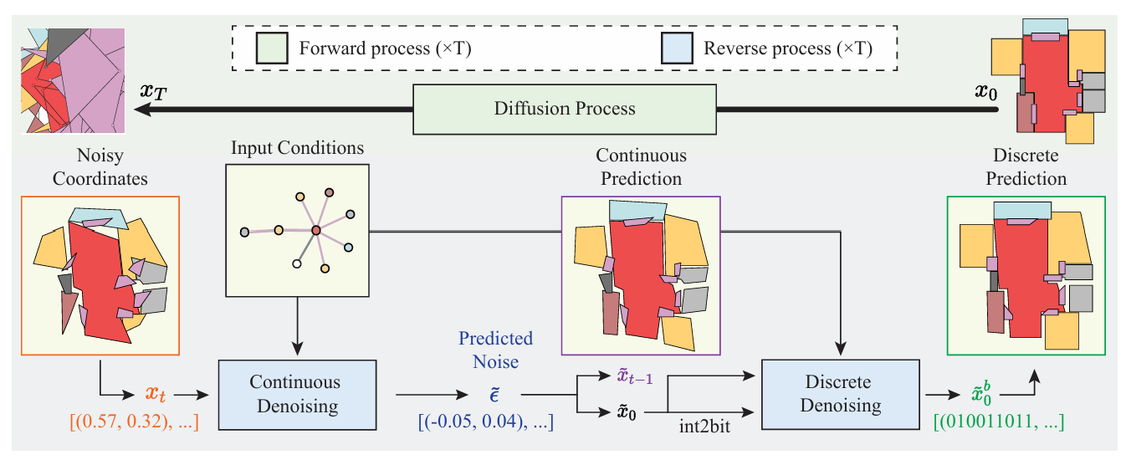
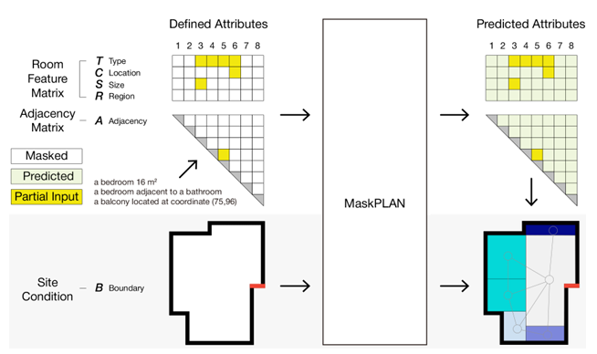
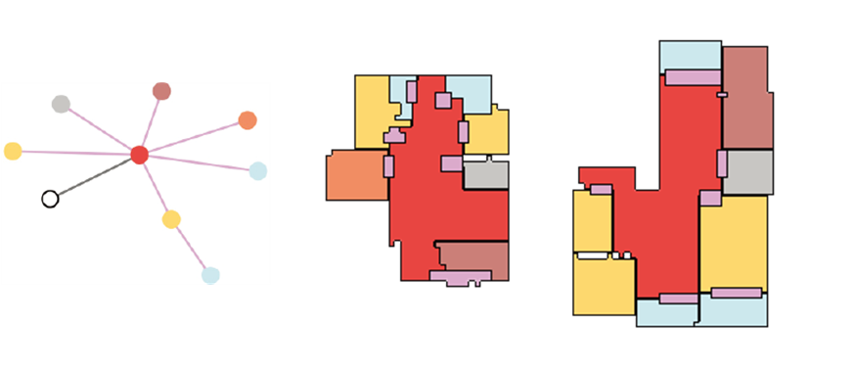
Related work
In the past decade, floorplan generation has shifted from rule-based optimization to deep learning, with growing emphasis on intelligence and quality.
Nauata et al. 2020
Chen et al. 2020
Hu et al. 2020
Para et al. 2021
Wu et al. 2019
Nauata et al. 2021
He et al. 2022
Sun et al. 2022
Shabani et al. 2023
Zhang et al. 2024
Notes:
Over the past decade, floorplan generation has advanced from dataset-driven automation. With deep learning, the field has rapidly progressed, greatly improving diversity and quality.

Slide 4
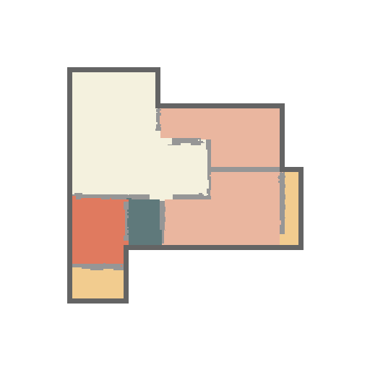
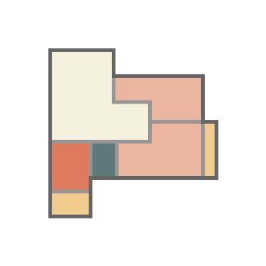


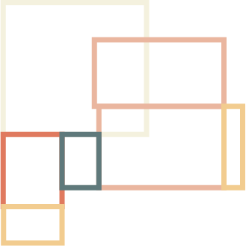
Research motivation
Image-based methods introduce noise and irregularities, while polygon-based methods cause geometric errors. Both require complex post-processing, breaking the end-to-end generation of floorplan.
Post-process
Image generation
Polygon geneation
Post-process
Notes:
Image-based methods introduce noise and irregularities, while polygon-based methods cause geometric errors. Both require complex post-processing, breaking the end-to-end generation of floorplan.

Slide 5
Challenge & Solution
Challenge
Ensure high-quality outputs without heavy post-processing
Avoid geometric misalignment and semantic inconsistency
Flexibly generate under constraints (e.g., boundaries, graphs)
Solution
FloorplanSBS: division-and-labeling scheme
Division stage: partition design space into rectangular patches
Labeling stage: assign semantic label to each patch
Output: directly obtain a vectorized floorplan
Notes:
Floorplan generation must deliver high-quality results without heavy post-processing, while avoiding misalignment and inconsistency under design constraints. We propose FloorplanSBS, a division-and-labeling framework. FloorplanSBS partitions the space into patches and labels each one, directly producing a vectorized floorplan in an end-to-end way.

Slide 6
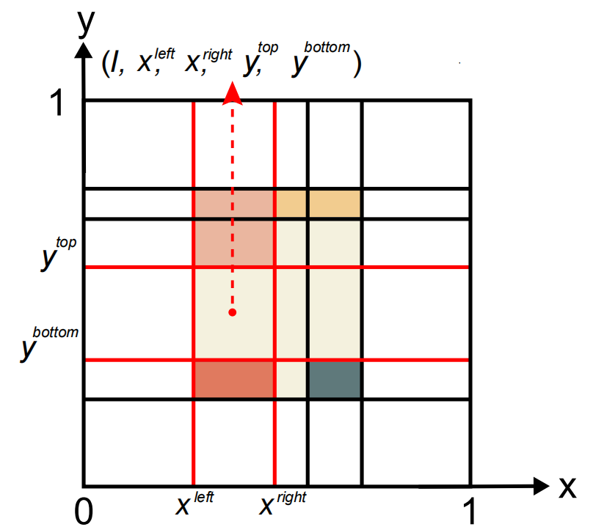
Floorplan representation
Representing floorplans as a collection of semantic patches enables precise and well-structured floorplan representation.
Notes:
In our method, a vector floorplan is mapped to a unit design space and partitioned with horizontal and vertical scanlines into rectangular patches. Each patch inherits a room label if inside the layout, or an ‘outside’ label otherwise. Thus, the floorplan is represented as a set of semantic patches.

Slide 7
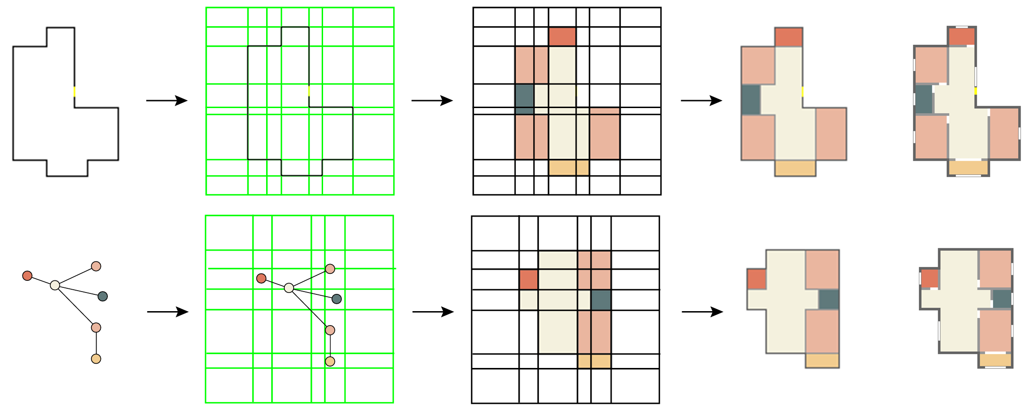
Overview
FloorplanSBS directly generates high-quality vectorized floorplans through patch generation and floorplan segmentation.
Notes:
Our method uses neural networks for spatial partitioning and semantic prediction. First, the design space is divided into rectangular patches; then each patch is labeled to form semantic patches, which are merged into a vectorized floorplan.

Slide 8
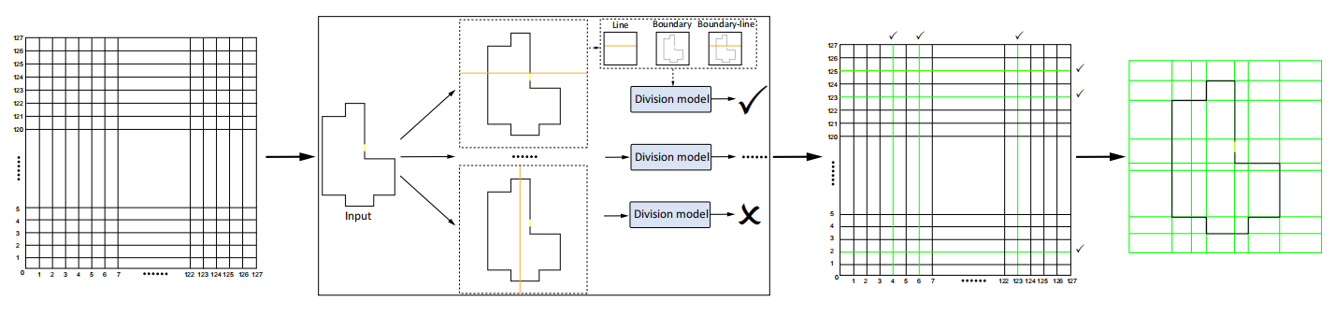
Patch generation
FloorplanSBS formulates scanline discrimination as a binary classification task, generating non-uniform pathches to support subsequent floorplan segmentation.
Notes:
The design space of a floorplan is discretized into a 128×128 uniform patch, yielding 128 horizontal and 128 vertical scanlines as candidates. A division model performs binary classification on each candidate to determine whether it is used for partitioning. Finally, the selected scanlines divide the space into non-uniform rectangular patches.

Slide 9
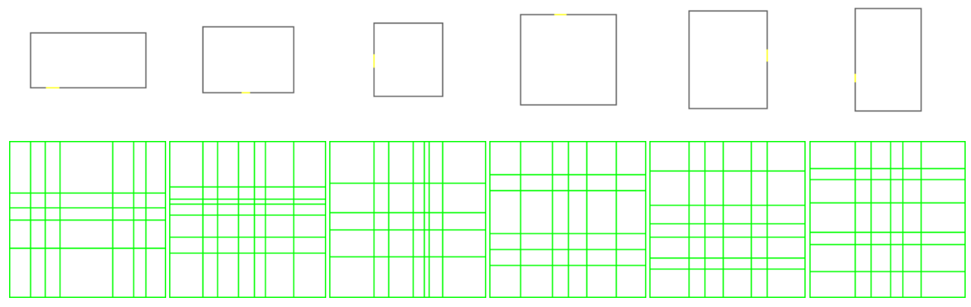
Patch generation
The patch generation produces adaptive non-uniform patches tailored to different floorplans, providing a structural foundation for floorplan generation.
Notes:
Different boundary shapes produce distinctive non-uniform patches after division. These patches adapt to boundary contours and provide a structural backbone for subsequent room partitioning.

Slide 10
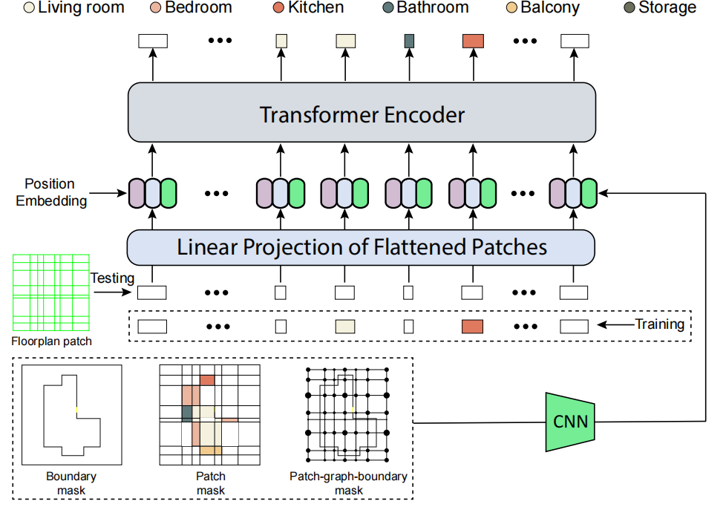
Floorplan segmentation
FloorplanSBS employs a Transformer to integrate geometric and contextual information, enabling accurate semantic labeling of patches.
Notes:
A semantic labeling model assigns labels to each non-uniform patch. Inspired by ViT, we partition the design space into rectangular patches and feed them into a Transformer encoder, which predicts the semantic label of each patch to complete semantic segmentation.

Slide 11
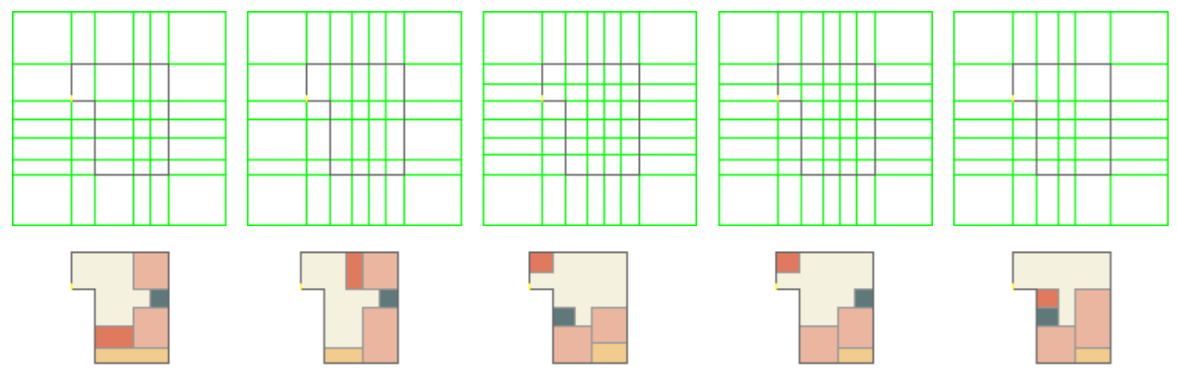
Floorplan segmentation
FloorplanSBS transforms geometric patches into semantic room layouts, achieving generation from structure to function.
Notes:
After partitioning, a labeling model assigns semantics to each patch, converting them into functional layouts. Adjacent patches with the same label are merged into rooms, efficiently reconstructing a vectorized floorplan with consistent structure.

Slide 12
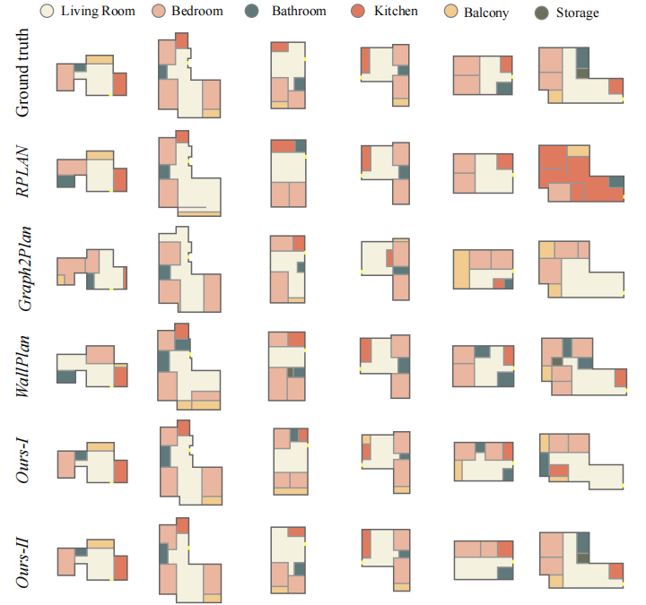
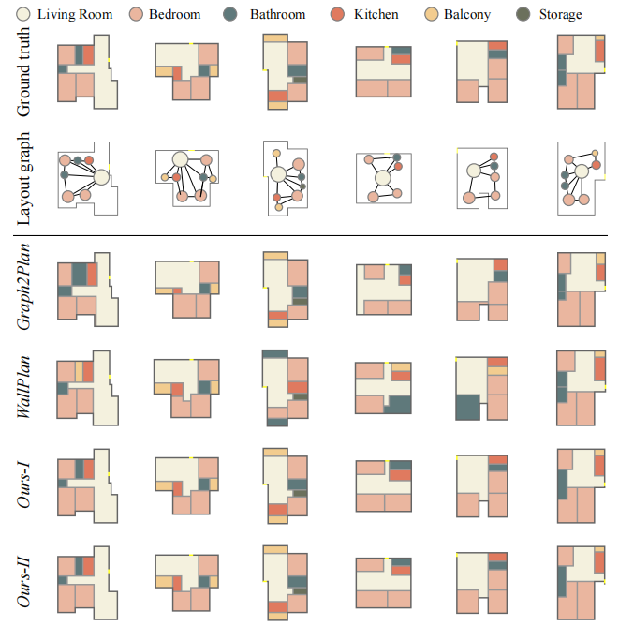
Qualitative evaluation
FloorplanSBS aligns more closely with real designs in both spatial structure and semantic functionality.
Notes:
Qualitative comparison with representative models shows that FloorplanSBS not only generates diverse floorplans but also ensures functional validity and topological consistency.

Slide 13
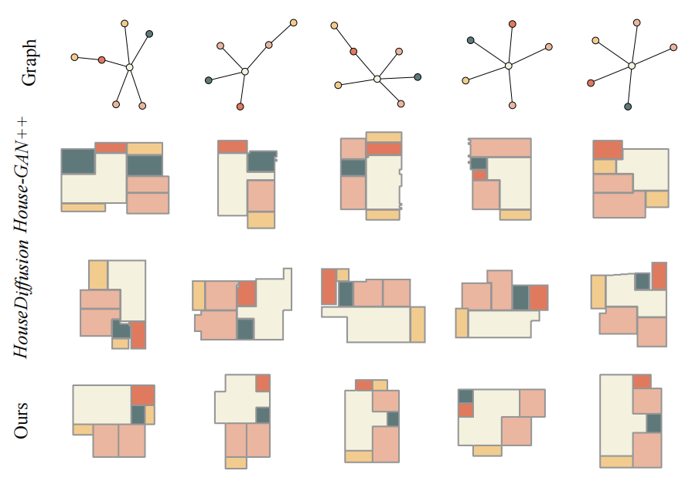
Qualitative evaluation
Under topological constraints, FloorplanSBS achieves both structural validity and semantic consistency, outperforming existing methods.
Notes:
This comparison under given topological constraints shows that our method produces more regular and well-organized floorplans while strictly preserving topology.

Slide 14
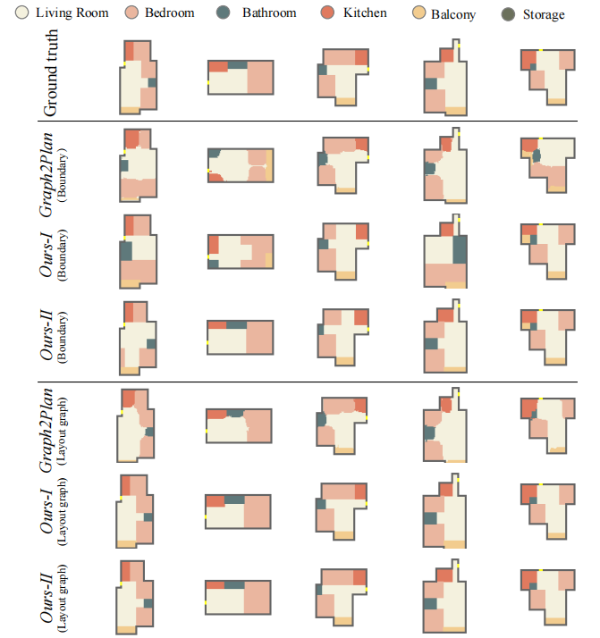
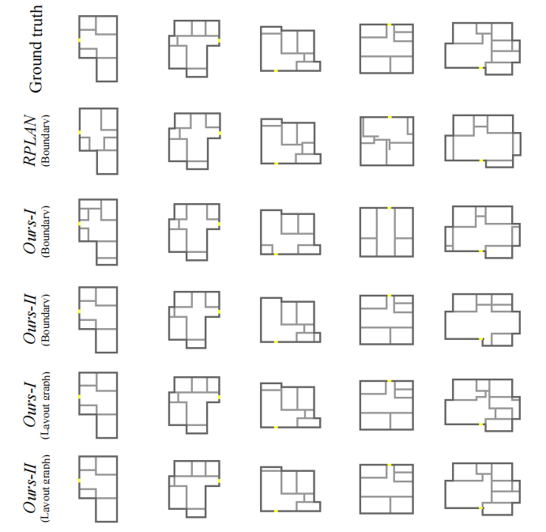
Qualitative evaluation
FloorplanSBS demonstrates superior generation quality and stability under both boundary and topological constraints.
Notes:
This slide compares two constraints. With boundary constraints, our methods generate more regular and realistic layouts than Graph2Plan or RPLAN. With topological constraints, our model better preserves adjacency and produces reasonable room divisions.

Slide 15
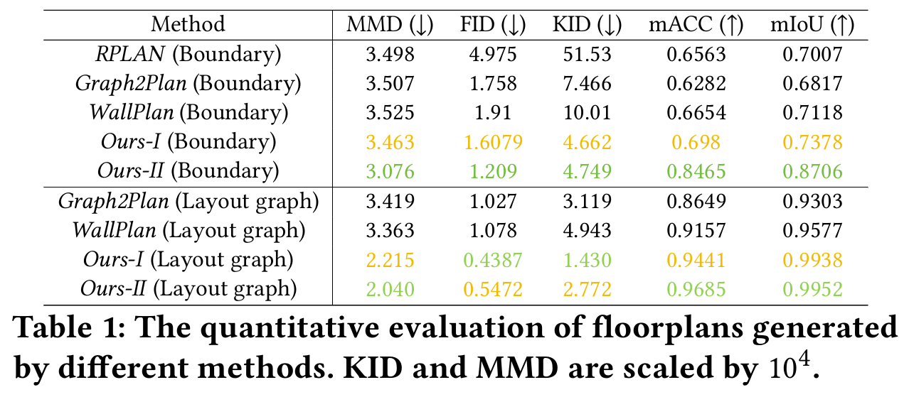
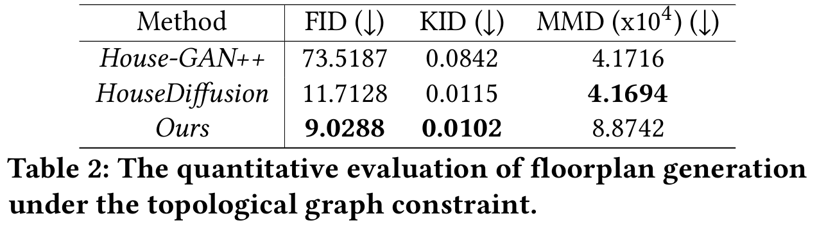
Quantitative evaluation
Our method achieves the best performance across all metrics and clearly outperforms existing approaches under both boundary and topological constraints.
Notes:
We compare our method with RPLAN, Graph2Plan, and WallPlan. In Table 1, our method achieves the best scores in all metrics. Table 2 shows that under topological constraints, our method clearly outperforms House-GAN++ and HouseDiffusion.

Slide 16
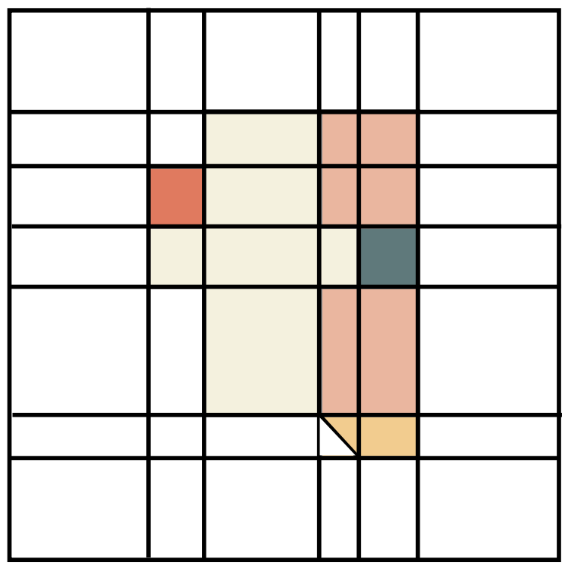
Scalability & Extension
FloorplanSBS exhibits strong scalability, extending to larger-scale and more complex spatial generation tasks.
Notes:
Our current grid partitioning is relatively regular, which may struggle with complex or curved structures. The framework can be extended to non-axis-aligned floorplans by adopting hybrid grids with varied shapes such as rectangles and triangles.

Slide 17

Acknowledgment
Thanks to the anonymous reviewers for their constructive comments
Supported by:
National Natural Science Foundation of China (Grant No. 62372152)
Open Project Program of the State Key Laboratory of CAD&CG, Zhejiang University (Grant No. A2412)
https://wutomwu.github.io/
Notes:
We would like to thank the anonymous reviewers for their helpful comments. This work was supported by the National Natural Science Foundation of China and the State Key Laboratory of CAD&CG, Zhejiang University. More information is available on my homepage via the QR code.

Slide 18
Thank you

